Slide 1
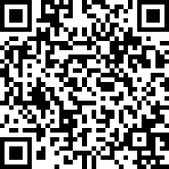
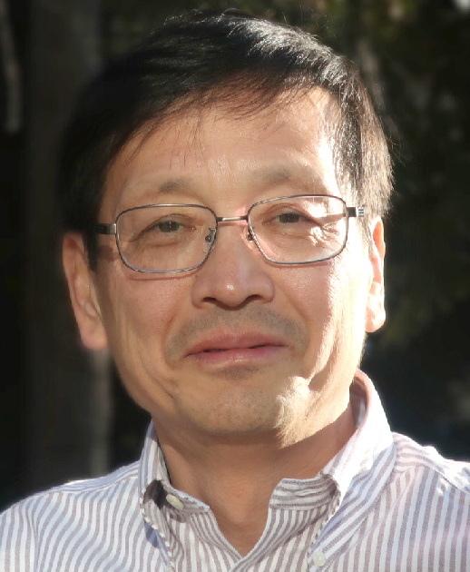
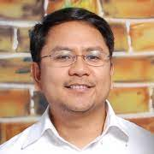



System design of inclusive society with infectious diseases
10TH
SDGS-ID Seminar
Co-Host: C3 Overcoming Infectious Diseases
COVID-19
Research Updates
Feb.18 (Fri), 2022
12:00-13:30 【Zoom】
CHARGE-FREE
Register
https://forms.gle/irDNVgBX5ZR1tUKE9
Registration D/L: Feb.17(Thu)17:00
Speakers
- Program -
12:00-12:05 Opening remarks
12:05-12:25 Talk 1 Hitoshi Oshitani
(Professor of GSM, TU)
"Epidemiology of COVID-19 in Japan
and the world“
12:25-12:45 Talk 2 Clyde Dapat
(Lecturer of GSM, TU)
"Genetic evolution of SARS-CoV-2 in the
world: from Alpha to Omicron and Beyond"
12:45-13:20 Q&A
13:20-13:30 Wrap up
Hitoshi Oshitani
Clyde Dapat
System design of inclusive society with infectious diseases
■SDGS-ID Website：http://www.sdgs-id.med.tohoku.ac.jp
■Inquiry：sdgs-id@med.tohoku.ac.jp
C3 Overcoming Infectious Diseases
http://impact.bureau.tohoku.ac.jp/contents/c3_infectious_disease.html-

